Slide 1
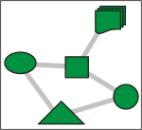
Modeling Clock Synchronization in the
Chess gMAC WSN Protocol
Mathijs Schuts Feng Zhu Faranak Heidarian
Frits Vaandrager
To appear in
Proceedings QFM’09

Slide 2
Plan
Intro to WSN and Chess case study
Recap of previous results
Our new model
Results
Conclusions

Slide 3
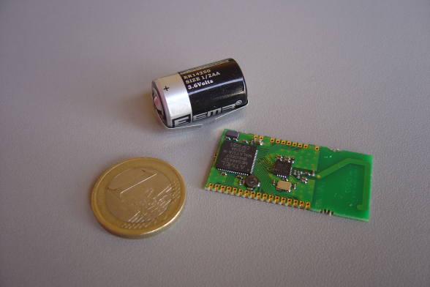
Chess 2.4 Ghz WSN

Slide 4
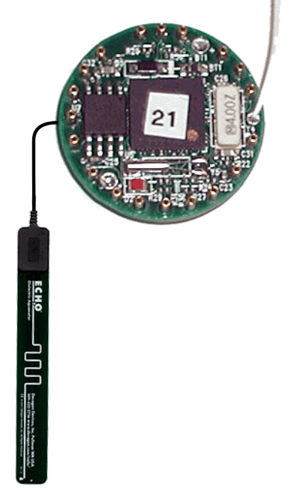
Sensor Network
Antenna
Server
Interface electronics, radio and microcontroller
Soil moisture probe
Sensor field
Communications barrier
Mote
Gateway
Internet

Slide 5
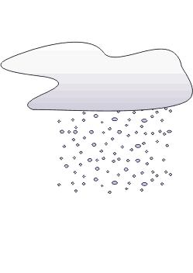

Sensor Network
Server
Watershed
Sensor field
Gateway
Internet

Slide 6
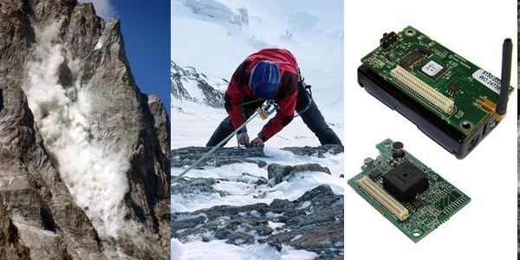
Application: Permasense Project

Slide 7

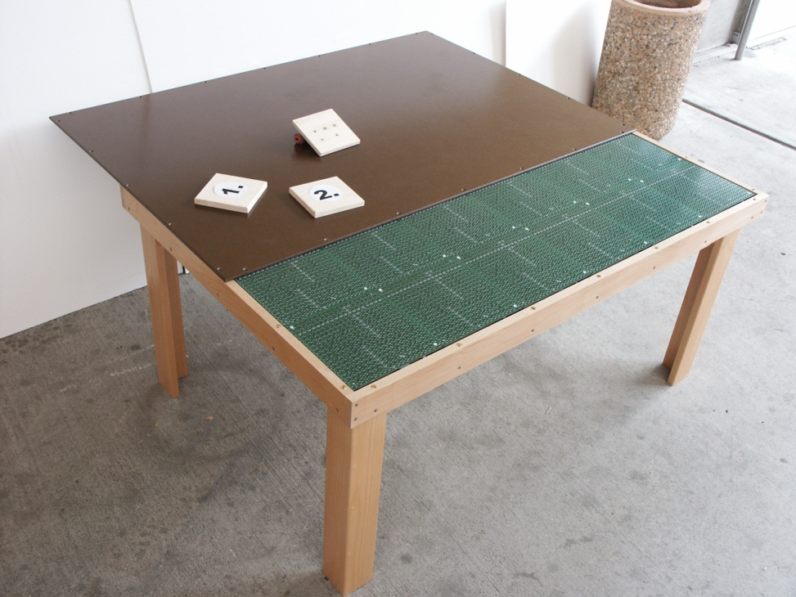
Application: “Smart Kindergarten”

Slide 8
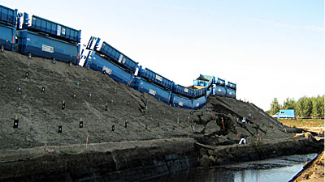
Application: IJkdijk

Slide 9
Case Study for Quasimodo Project
Model, design and analyze gossip based WSN of Chess, based on
informal specification in deliverable, and
discussions with experts

Slide 10
Our Focus: Clock Synchronization
Time is considered as a sequence of Time Frames.
A Time Frame
A time frame is composed of a fixed number (C) of Time Slots.
RX
tsn
TX
RX
idle
idle
idle
idle
In a time slot the hardware clock of the sensor node ticks a fixed number (k₀) of times.
Notes:
The Medium Access Control (MAC) layer is responsible for regulating the access to the wireless shared channel. Medium access control is of fundamental importance in sensor networks in order to reduce conflicts as much as possible, thus maintaining the network capacity to a reasonable level. Collision avoidance, energy efficiency, scalability in node density, latency, fairness, throughput, and bandwidth utilization are important attributes of a good MAC protocol.
In the approach of Chess Company, each node takes time as a sequence of time frames, and each time frame is made up of a number of time slots that may be either active or idle. In the active time slots, the node can transmit or receive. A node, can transmit a message only once per time frame in a single time slot called TX slot. On the other hand, the node may receive messages of its neighbor nodes in the other active slots, which are specified for receiving and called RX slots. The TX slot and the RX and idle slots of a node are arranged in a particular order, called TDMA schedule of that node, thus, for each node, each slot is characterized by a type RX slot, TX slot, or idle slot and an order of operation.
We assume that all the active slots of a node are massed in the beginning of a time frame, followed by idle slots. All RX slots are identical and in each of them the node can receive a message from any of its neighbors, and the only TX slot should be scheduled in a way that no communication collision exists between the neighbors.
10

Slide 11
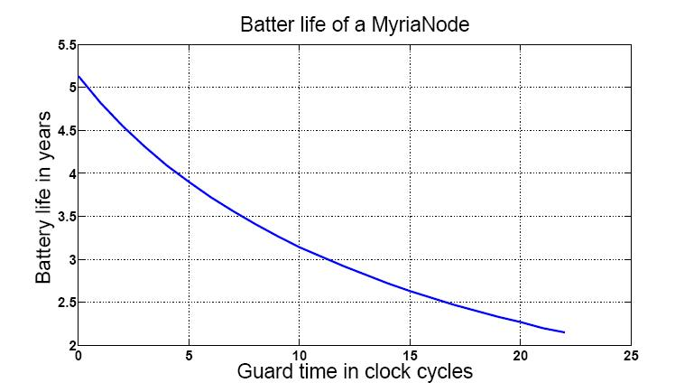
Goal: Minimalize Energy Consumption
TX Time Slot
Guard Time
Guard Time
RX Time Slot

Slide 12
UPPAAL Model from FM2009 Paper
A Wireless Sensor Node
Clock
x>=min
clk[id]==guardtime
X₀
Start_TX_Slot
start_message!
Sending
tick[id]!
x<=max
x:=0,
clk[id]:=(clk[id]+1)%k₀
csn[id]==tsn[id]
clk[id]==k₀-guardtime
urg!
tick[id]!
csn[id]!=tsn[id]
Synchronizer
tick[id]?
INIT
Wait_For_End_Of_Slot
csn[id]<=n
S₀
S₁
start_message?
clk[id]==0
urg!
csn[id]:=(csn[id]+1)%C
tick[id]?
clk[id]:=guardtime+1
Notes:
12

Slide 13
Heidarian, Schmaltz, Vaandrager (FM2009)
Full parametric analysis for clique networks
Parameter constraints found using Uppaal
Proof fully checked using Isabelle/Hol (> 5000 lines)
Correctness also studied with Uppaal for line topologies

Slide 14
Heidarian, Schmaltz, Vaandrager (FM2009)
Full parametric analysis for clique networks
Parameter constraints found using Uppaal
Proof fully checked using Isabelle/Hol (> 5000 lines)
Correctness also studied with Uppaal for line topologies
Model does not correspond to Chess implementation!!!

Slide 15
How Current Implementation Works
Clocks only synchronized once per frame
Implementation computes median of phase errors of all messages received in frame
Offset = median * gain
Radio switching time is relevant

Slide 16
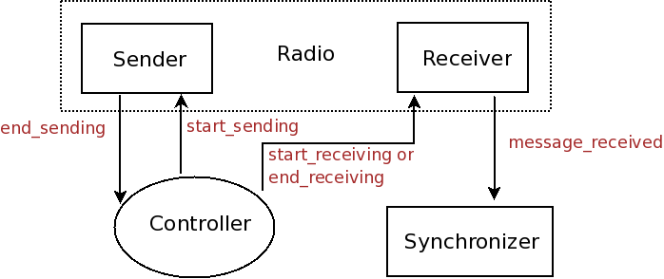
Structure of Uppaal Model

Slide 17
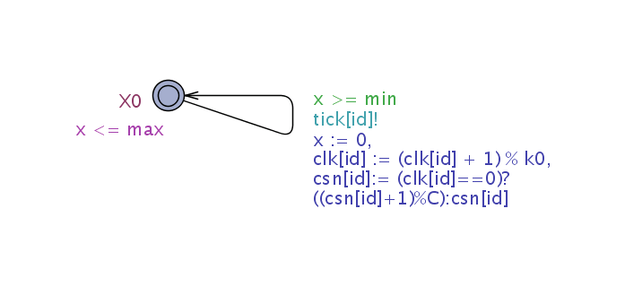
Clock

Slide 18
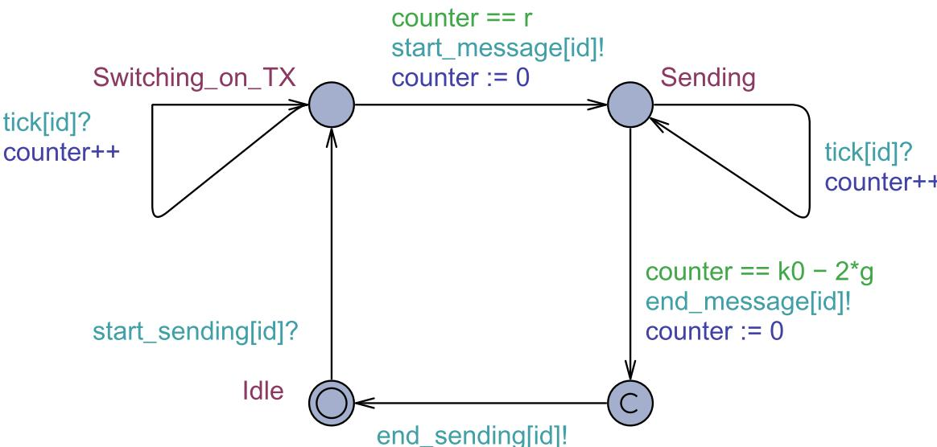
Sender

Slide 19
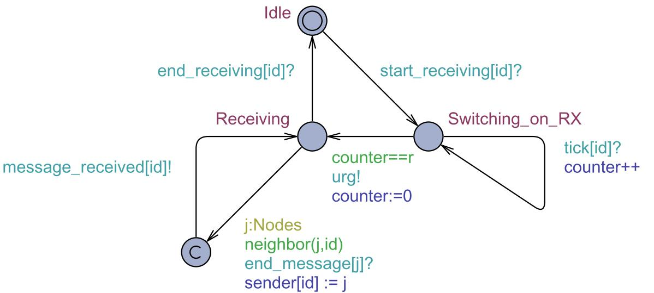
Receiver

Slide 20
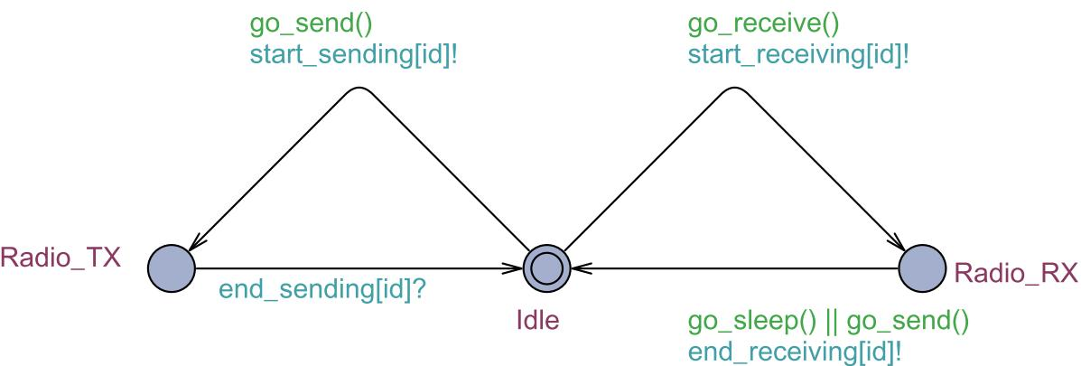
Controller

Slide 21
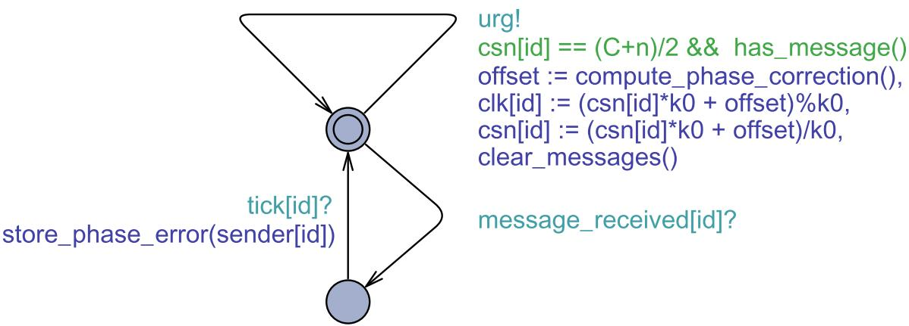
Synchronizer

Slide 22
compute_phase_correction()
if (number of received messages == 0)
offset = 0;
else if (number of received messages <= 2)
offset = the phase error of the first received message * gain;
else
offset = the median of all phase errors * gain

Slide 23
Invariants for Correctness
“Whenever I send all my neighbors listen”
INV1 : A[] forall (i: Nodes) forall (j : Nodes)
SENDER(i).Sending && neighbor(i,j)imply RECEIVER(j).Receiving
“My neighbors never send simultaneously”
INV2 : A[] forall (i:Nodes) forall (j:Nodes) forall (k:Nodes) SENDER(i).Sending && neighbor(i,k) && SENDER(j).Sending && neighbor(j,k) imply i == j
“There’s no deadlock”
INV3 : A[] not deadlock

Slide 24
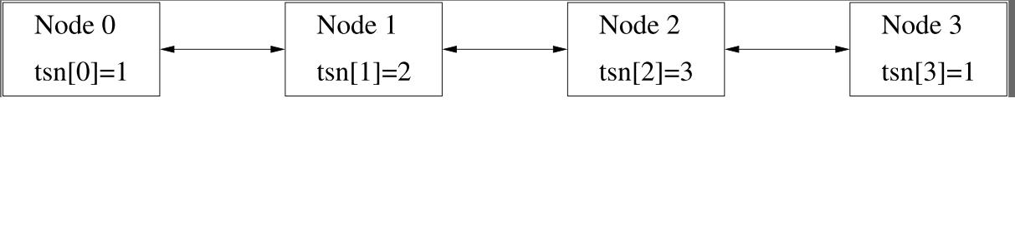
Counterexample found by Uppaal

Slide 25
Counterexample!
Server
Watershed
Sensor field
Gateway
Internet
Slow nodes
Fast nodes

Slide 26
How to Fix the Problem?
Assegei (2008) proposed use of Kalman filter instead of median algorithm
FM2009 algorithm, possibly with gain factor?
Algorithm of Lenzen, Lochen & Wattenhofer (2008)?
Adaptation of algorithm of Pussente & Barbosa (2009)?
It should be easy to adapt our Uppaal model

Slide 27
Probabilistic Challenges
Probabilistic model of message loss
Probabilistic algorithms for (dynamic) slot allocation
Probabilistic leaving/joining of nodes/networks
Probabilistic algorithms for gossiping
…
Key design issue: independence of layers?!?!!

Slide 28
Conclusions
Our contribution: Model of clock synchronization in current implementation of Chess. Analysis with Uppaal revealed bug
Never trust your models! Modeling is difficult
Demo of protocol flaw in preparation
Model based testing?!
Model checking useful, even if one can only handle trivial instances
In this area, models are imperfect approximations of reality (“Physicists approach to modeling”)
Many probabilistic challenges!!

Slide 29
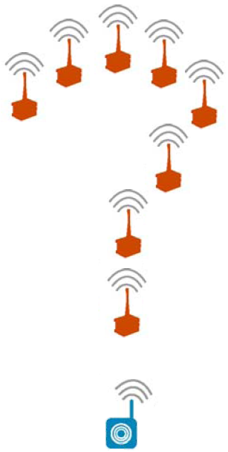
Questions?
Notes:
29

