Slide 1
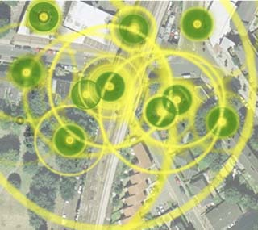
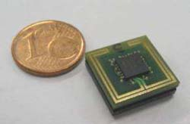
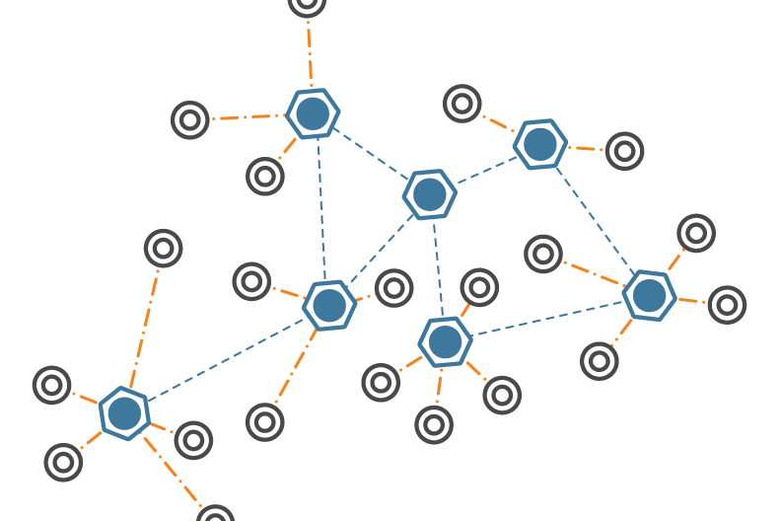
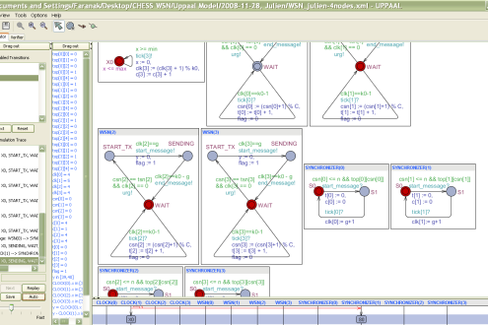

Analysis of a
Clock Synchronization Protocol for Wireless Sensor Networks
Faranak Heidarian
Julien Schmaltz
Frits Vaandrager

Slide 2
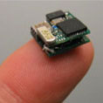
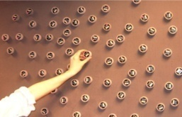
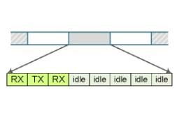
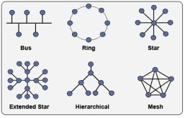

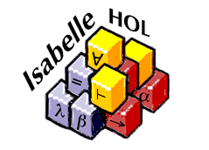
Outline
Introduction
Synchronization Algorithm
Time Model
UPPAAL Model
Error Scenarios
Clique Topology
Line Topology
Conclusion

Slide 3
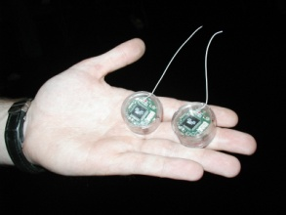
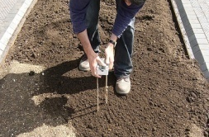
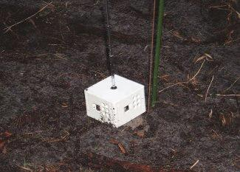
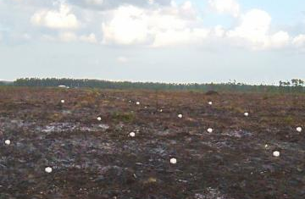
Introduction
Notes:
In computer science and telecommunications, wireless sensor networks are an active research area.
In a nutshell, a Wireless Sensor Network (WSN) is a wireless network consisting of spatially distributed autonomous devices using sensors to cooperatively monitor physical or environmental conditions, such as temperature, sound, vibration, pressure, motion or pollution, at different locations.
They are now used in many industrial and civilian application areas, including industrial process monitoring and control, machine health monitoring, environment and habitat monitoring, healthcare applications, home automation, and traffic control.
A sensor node is typically equipped with:
one or more sensors
a radio transceiver or other wireless communications device,
a small microcontroller
an energy source, usually a battery
Size: A sensor node might vary in size from that of a shoebox down to the size of a grain of dust, although functioning "motes" of genuine microscopic dimensions have yet to be created.
Price: The cost of sensor nodes is ranging from hundreds of dollars to a few cents, depending on the size of the sensor network and the complexity required of individual sensor nodes.
A sensor network normally constitutes a wireless ad-hoc network, meaning that each sensor supports a multi-hop routing algorithm (several nodes may forward data packets to the base station).

Slide 4
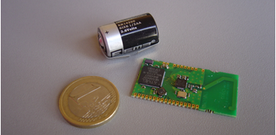

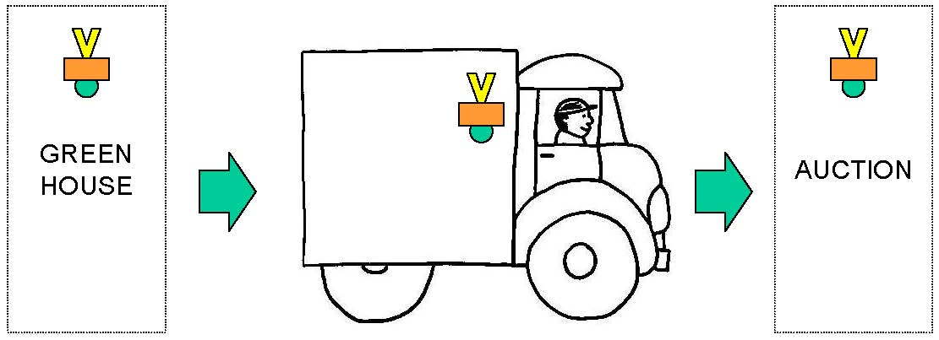
Flower Auction
Use Case I : asset management
theft detection and resolving ownership disputes
Use Case II : supply chain management
real-time awareness (track and trace)
Notes:
Use Case I : asset management
theft detection and resolving ownership disputes
Use Case II : supply chain optimisation
real-time awareness (track and trace)

Slide 5
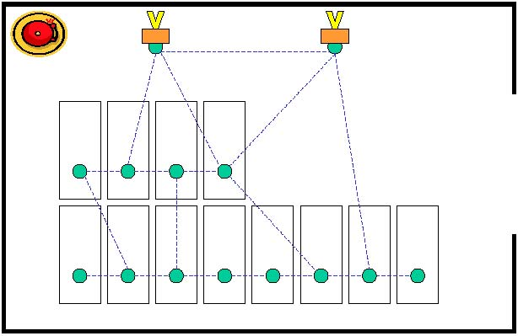
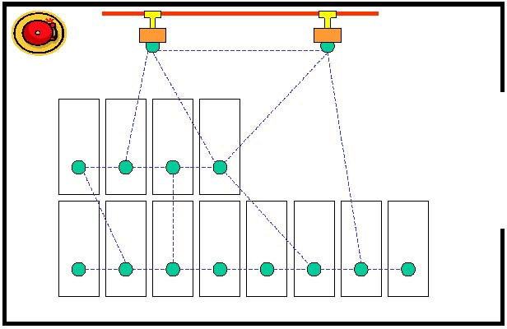
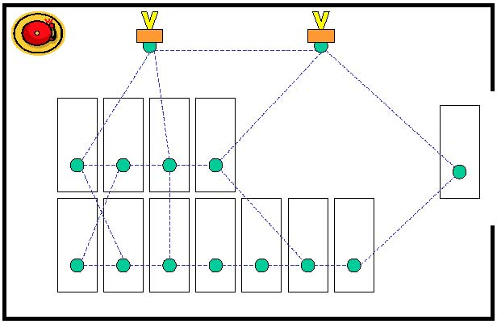
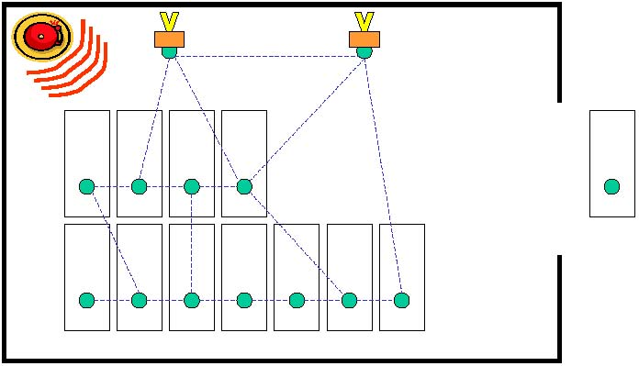
Theft Detection
Active tag ad-hoc network topology is shown in blue
Observation nodes can be connected to fixed local infrastructure
Dynamic Topology
When the network detects a node is lost, alarm is raised .
Notes:
Active tag ad-hoc network topology shown in blue
Observation nodes can be connected to fixed local infrastructure
Heterogeneous ownership is possible; this is third tier knowledge
Dynamic topology; robust communication in RF-noisy environments

Slide 6

Time Model
Time is considered as a sequence of Time Frames.
A Time Frame
A time frame is composed of a fixed number, say C, of Time Slots.
RX
tsn
TX
RX
idle
idle
idle
idle
In a time slot the hardware clock of the sensor node ticks a fixed number, say k₀, of times.

Slide 7
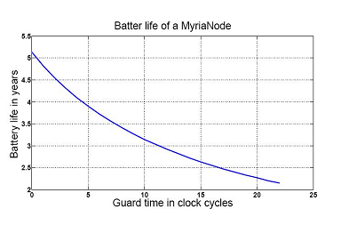
Guard Time
g
TX Time Slot
t
SENDING
RX Time Slot
Notes:
A Guard Time is allocated at the beginning of each TX slot to accommodate timing skew among the oscillators of the nodes. It is also required after the message to allow the transmitter to return to a quiescent state.
As the network does nothing during the guard time, guard time is wasting energy.
The more the guard time is, the less the battery life is.

Slide 8
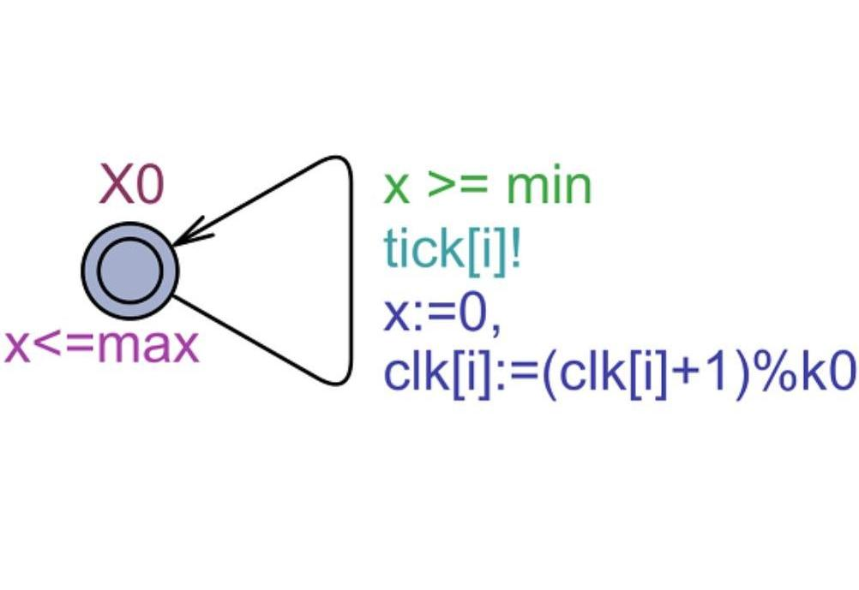
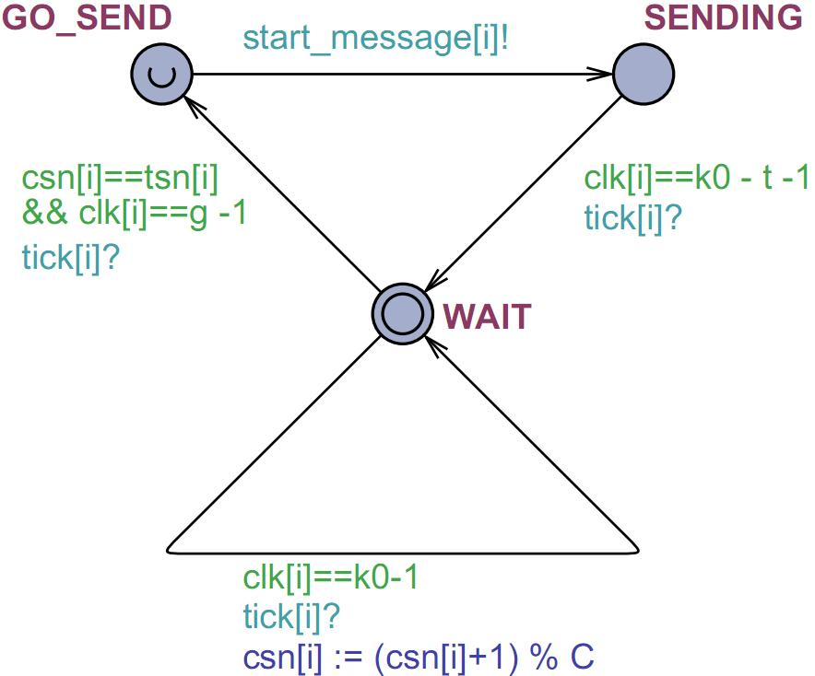
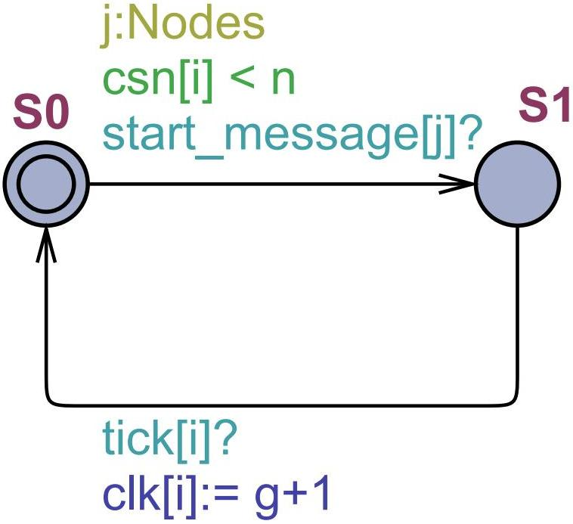

Uppaal Model
Clock
A Wireless Sensor Node
Synchronizer

Slide 9
Synchronization
Definition. A network is synchronized if and only if for all reachable states
(∀i, j ∈ Nodes)(SENDING_{i} and neighbor(i,j)⇒ csn[i] = csn[j])
A
Collision
1
2
TX
3
B
1
TX
2
3
C
1
2
3
Notes:
A wireless sensor network is Synchronized Collision-Free if no two nodes transmit, simultaneously and the receiver nodes are able to get the message of the transmitter in RX slots with the same slot number as the transmitter.

Slide 10
Conditions of Protocol Synchronization
Theorem. A wireless sensor network with clique topology is synchronized if and only if three conditions hold:
M : the maximum distance between two consecutive active slots

Slide 11
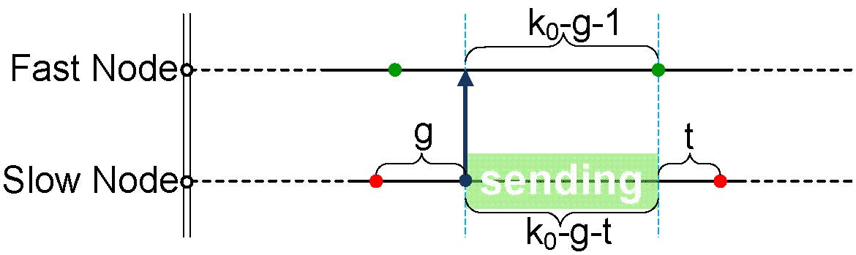
Proving Necessity
Fast Receiver- Slow Sender, during transmission
To exclude this scenario, the following condition should be satisfied:

Slide 12



Proving Sufficiency
Hand-proof
  1000 lines of formulae
  Complex large invariants
  Needs some history variables
Formal proof
  Isabelle/HOL theorem prover
  About 5,000 lines
  Needs a proof for every single step!

Slide 13
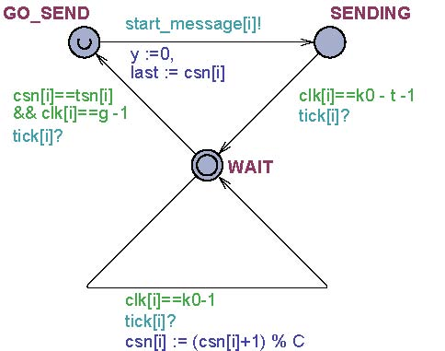
Some Invariants

Slide 14
Different Topologies
g = 2 | g = 3 | g = 3 | g = 4 | g = 3 | g = 3
ρ = 29/30 | ρ = 58/59 | ρ =38/39 | ρ = 58/59 | ρ = 58/59 | ρ = 48/49

Slide 15
Line Topology
We claim that for a line network of size N, the guard time g should be at least N. We consider only networks with perfect clocks, in which clock drift is zero.

Slide 16
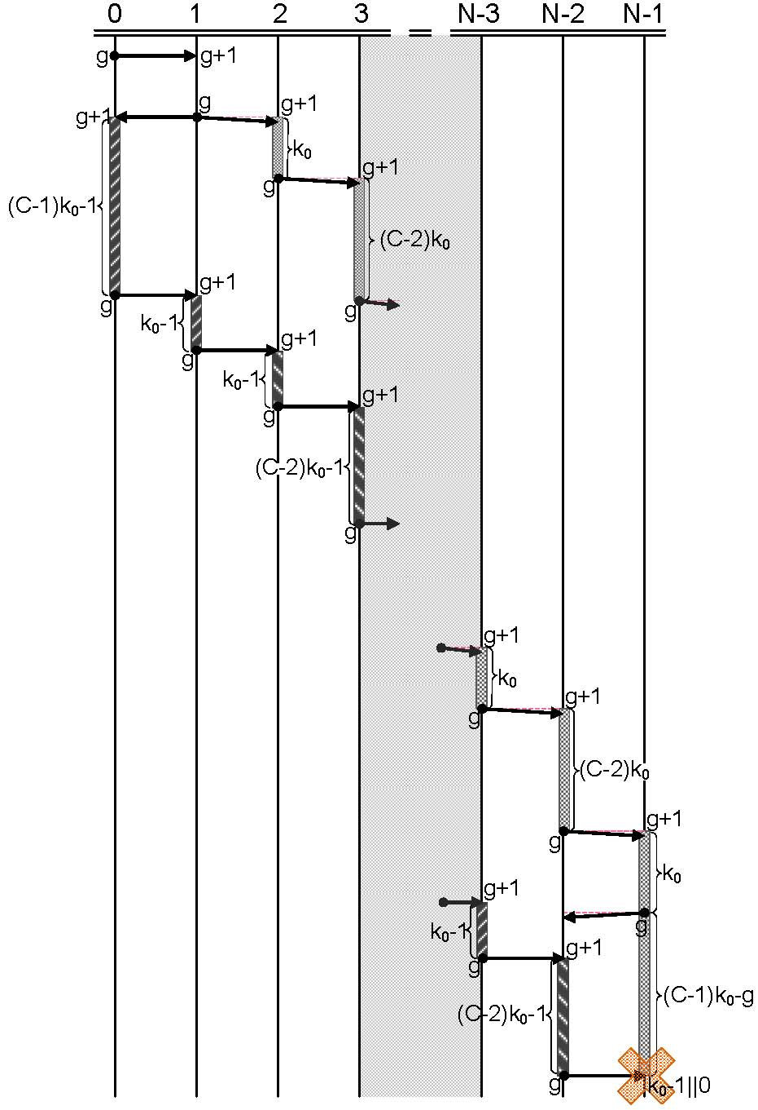
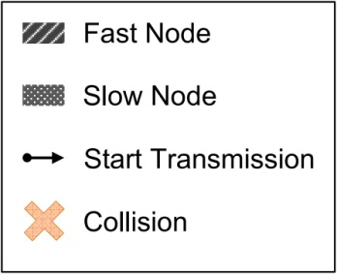
An Error Scenario

Slide 17
Conclusion
We proved the correctness of model of Chess algorithm under some assumptions; however, the current implementation has flaws.
Model checking helped us to find the error scenarios and parameter constraints for our model.
Invariant proof is complicated.
    Using Isabelle/HOL ,we did not discover any mistakes in the hand proof. However, there was some places that needed some expansion (1 line of hand proof can be equivalent to 100 lines in Isabelle). These places were the core places explaining some details of the protocol.

Slide 18
Future Work
Correcting/Improving the Protocol and Proving its correctness.
Adding a gain factor
Using Kalman filter (Assegei, 2008)
Using algorithm of Lenzen, Locher & Wattenhofer (2008)
Adapting the algorithm of Pussente & Barbosa (2009)
  (Usually, it is easy to adapt our Uppaal model.)
Using Parametric Timed Automata (Hune et al, 2002)
Using “Event Order Abstraction” (Umeno, 2008)
There are many Probabilistic Challenges
Notes:
Event Order Abstraction” (EOA): an abstraction technique for parametric safety verification of real-time systems in which “correct orderings of events” needed for system correctness are preserved by timing dependent behavior of the systems. in EOA
We first identify bad event orderings.
Then we automatically derive a set of timing constraints under which the system does not exhibit the identified bad event orderings.
Probabilistic model of message loss
Probabilistic algorithms for (dynamic) slot allocation
Probabilistic leaving/joining of nodes/networks
Probabilistic algorithms for gossiping
…
Key design issue: independence of layers?!?!!
Advertisement at the end: people who are interested to hear more about formal methods applied to the Chess case study are welcome to attend the Quasimodo meeting this afternoon!! There we will also present a demo illustrating the problem in the implementation.

Slide 19




Thank You

